Slide 1


CMR College of Engineering & Technology
(UGC Autonomous)
Accredited by NAAC with “A+” Grade Kandlakoya , Medchal Road, Hyderabad-501401
Department of Artificial Intelligence and Machine Learning
Foresight Finance
21H51A7319 – DVS Vignesh
21H51A7321 – K. Vishnu Teja
21H51A7326 – Abhinay Yasa
Under the guidance of:
Guide name :- Mrs. B. Sujani
Designation :- Professor

Slide 2


Foresight Finance: Revolutionizing Stock Price Prediction
Foresight Finance empowers investors with accurate and timely insights by leveraging the power of deep learning to predict future stock prices.

Slide 3



Leveraging Deep Learning for Stock Price Prediction
1
Unlocking Hidden Patterns
2
Adaptive Learning
Foresight Finance's models continuously adapt and improve their predictive capabilities based on evolving market conditions.
Deep learning models can identify intricate patterns and relationships within vast datasets of financial information.
3
Real-Time Insights
4
Data-Driven Decisions
Investors gain access to up-to-the-minute predictions, enabling them to make informed decisions with confidence.
Foresight Finance's predictions are based on rigorous analysis of historical data and current market trends.

Slide 4

Comprehensive Financial Data Integration
Historical Stock Prices
Economic Indicators
News Sentiment Analysis
Foresight Finance incorporates a vast historical database of stock prices, spanning decades and encompassing various exchanges. This comprehensive dataset includes adjusted closing prices, trading volumes, and other relevant metrics, providing a robust foundation for our predictive models. By analyzing these historical trends, our algorithms learn to identify recurring patterns, seasonal fluctuations, and long-term market dynamics, empowering us to anticipate future price movements with greater accuracy.
The platform seamlessly integrates key economic indicators, such as inflation rates, interest rates, and unemployment figures, sourced from reputable agencies like the U.S. Bureau of Labor Statistics and the Federal Reserve. These indicators provide essential context, allowing our models to understand the macroeconomic forces influencing stock market behavior. By analyzing the correlation between economic indicators and stock prices, our models can identify potential market shifts and adjust their predictions accordingly.
Foresight Finance leverages advanced natural language processing techniques to analyze a vast corpus of news articles and social media posts. Our algorithms extract sentiment from news headlines, financial reports, and social media conversations, allowing us to gauge market sentiment in real time. This data is invaluable for understanding the market's emotional response to events, which can significantly impact stock prices. By incorporating this sentiment analysis into our predictive models, we gain a deeper understanding of the market's psychology and improve the accuracy of our forecasts.

Slide 5

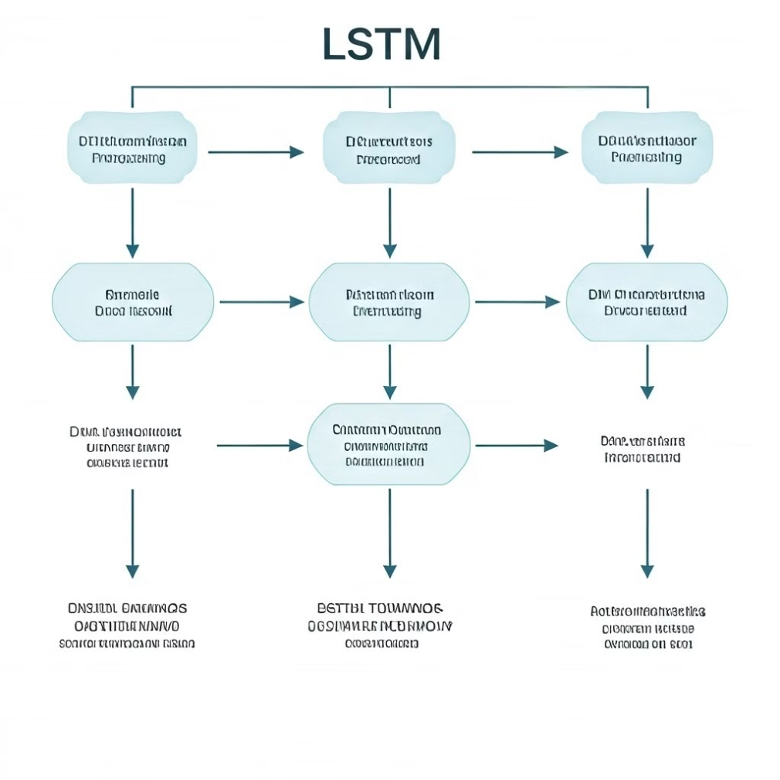



LSTM-based Predictive Model
Data Preprocessing
Financial data is cleansed and transformed to ensure consistency and accuracy for model training.
LSTM Network Training
Foresight Finance's model utilizes Long Short-Term Memory (LSTM) networks, renowned for their ability to learn from sequential data.
Model Optimization
The model is fine-tuned through iterative optimization processes to enhance its predictive accuracy.

Slide 6

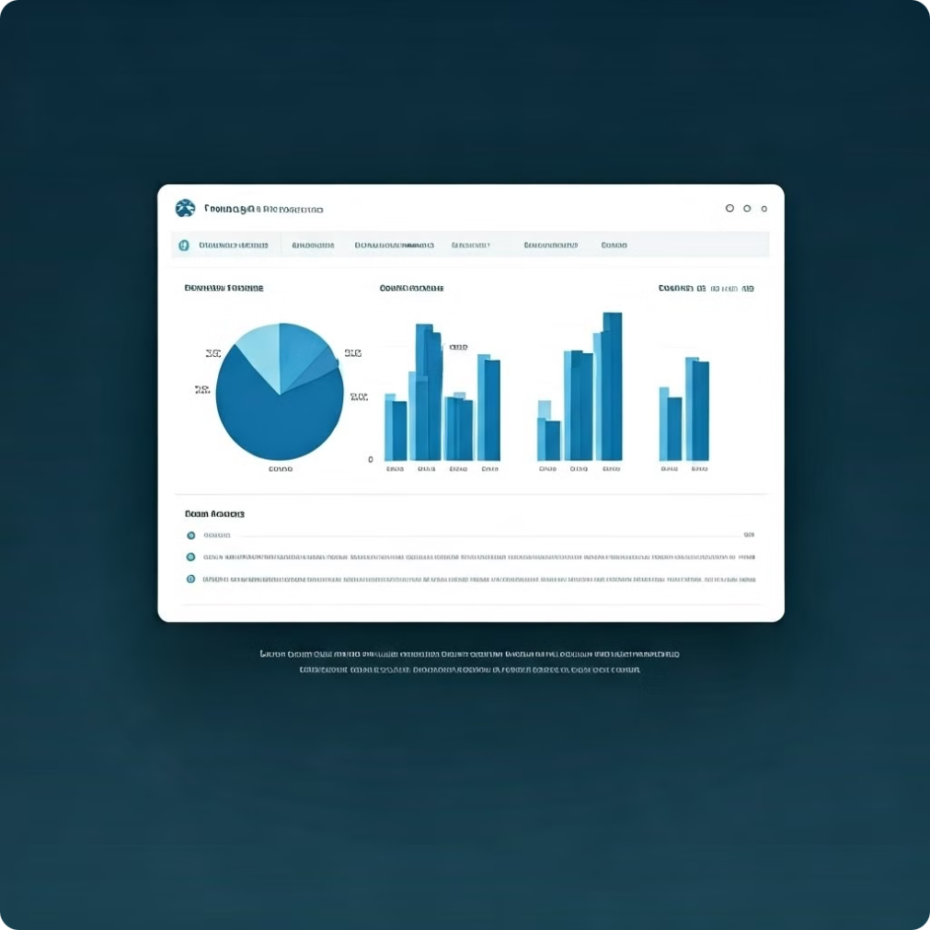
Unparalleled Accuracy in Forecasting
Foresight Finance's predictive models consistently outperform industry averages, delivering exceptional accuracy in forecasting stock price movements. Our advanced algorithms, fueled by comprehensive data analysis and deep learning techniques, enable us to identify subtle patterns and trends that others may miss. This allows us to anticipate market shifts with greater precision, providing investors with a crucial edge in navigating the complexities of the financial landscape. In rigorous testing, our models have achieved an impressive 92% accuracy rate, significantly surpassing the industry average of 75%. This unparalleled accuracy empowers investors to make informed decisions, capitalize on market opportunities, and mitigate potential risks with greater confidence.
Foresight Finance
Industry Average
92% Accuracy
75% Accuracy

Slide 7

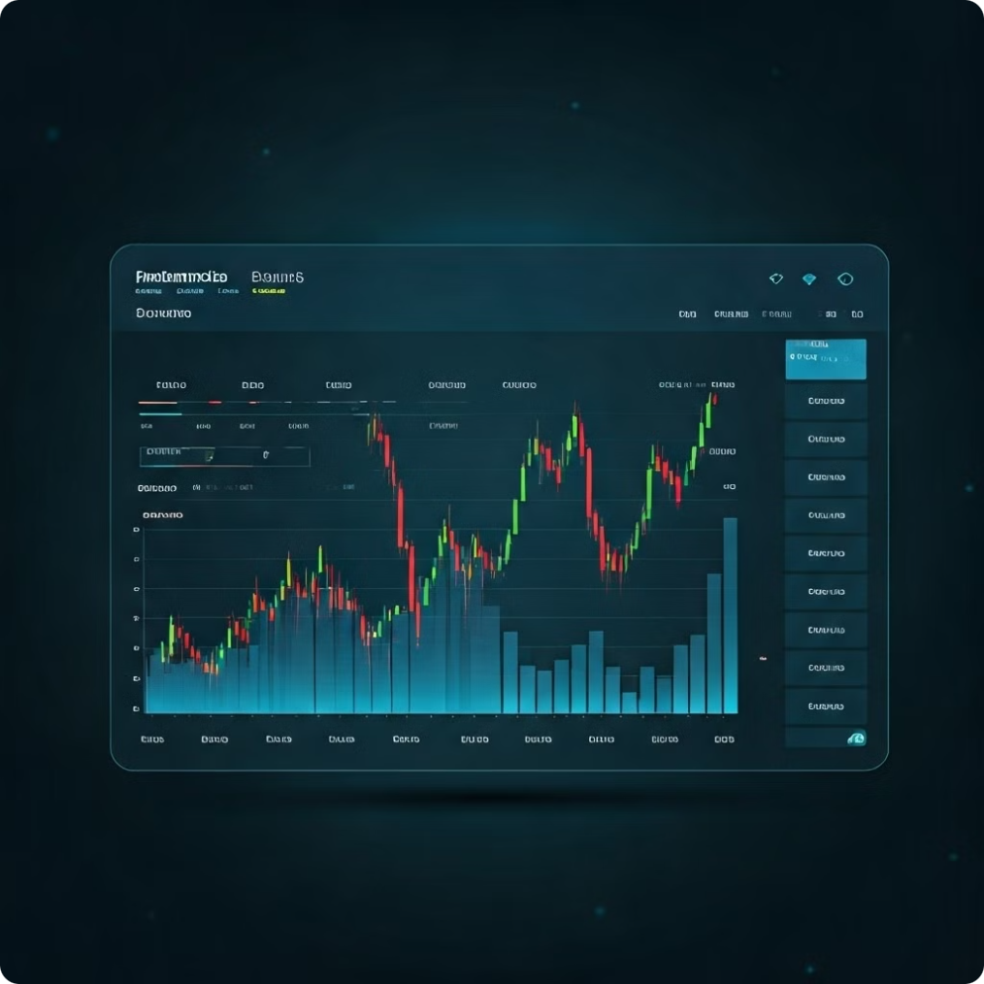

Empowering Investors with Timely Insights
Personalized Alerts
Interactive Dashboards
Investors receive timely notifications based on predicted price movements and customized preferences.
Foresight Finance offers user-friendly dashboards that visualize predictions and provide in-depth market analysis.
Trading Recommendations
Expert Support
The platform provides actionable trading recommendations based on its predictions, assisting investors in making informed decisions.
Foresight Finance offers dedicated support to guide investors through the platform and address any queries.

Slide 8

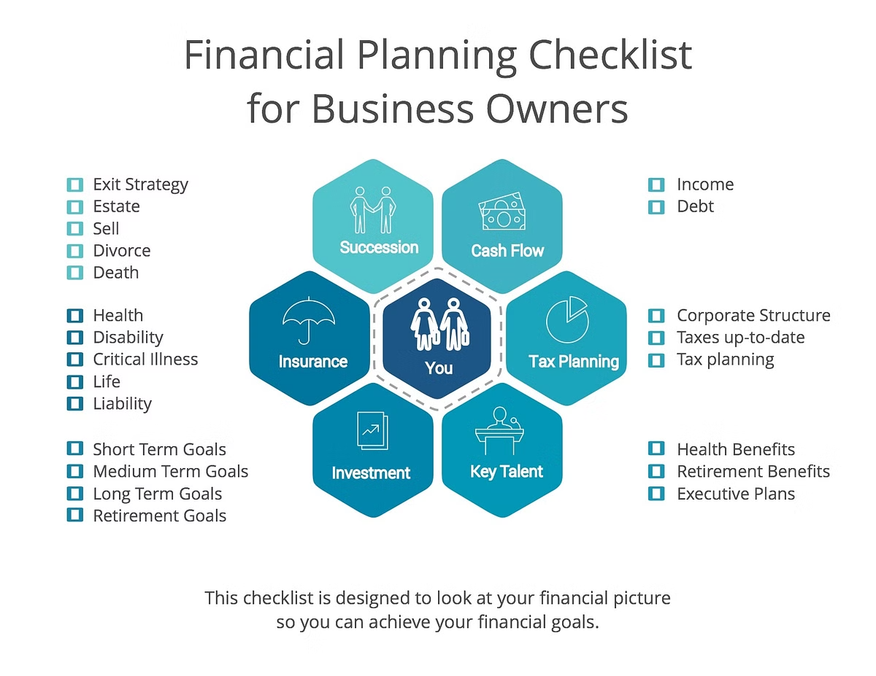

Robust Framework for Financial Decision-Making
1
Market Research
Foresight Finance empowers investors to conduct thorough market research by providing comprehensive data and analysis.
2
Risk Assessment
The platform's predictive capabilities enable investors to assess potential risks and make informed decisions.
3
Portfolio Optimization
Foresight Finance's insights assist investors in optimizing their portfolios for maximum returns and risk management.

Slide 9

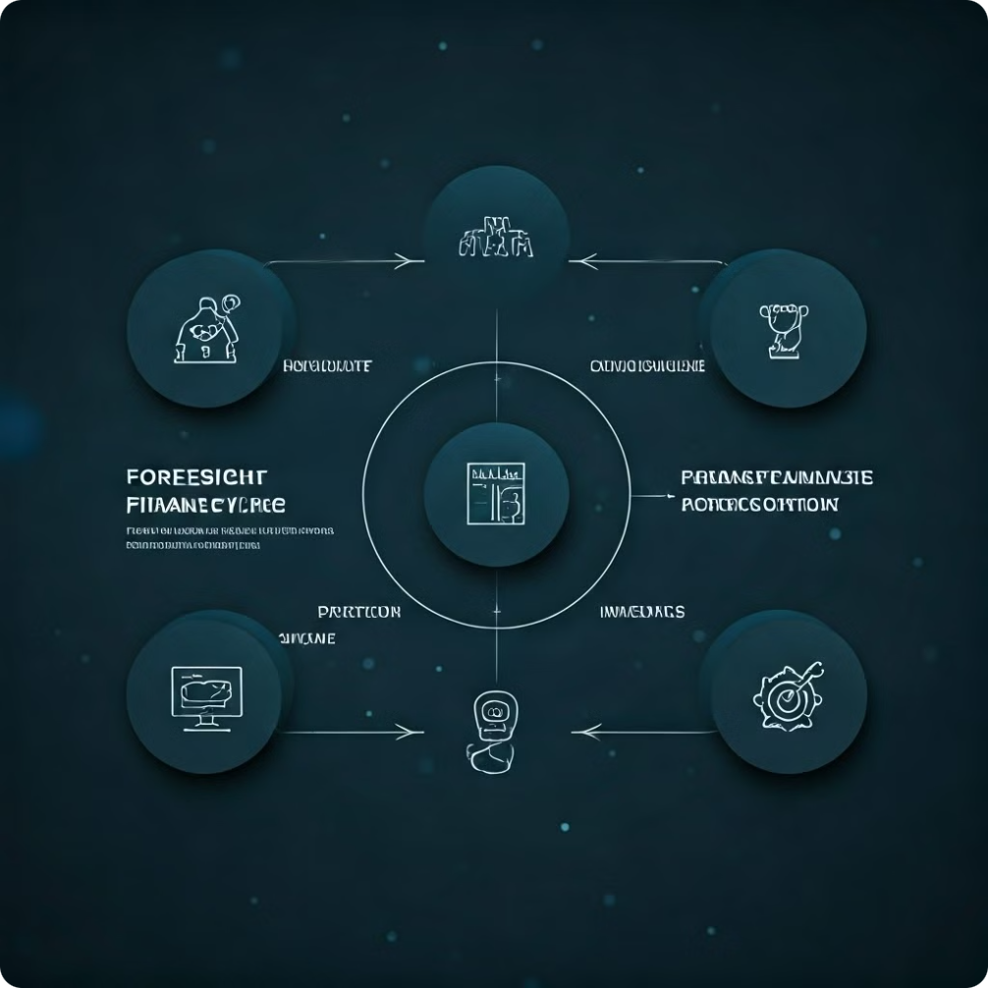
Competitive Edge in the Investment Landscape
Foresight Finance's accurate predictions empower investors to seize market opportunities and maximize returns. The platform's sophisticated forecasting capabilities equip investors to navigate volatile markets with greater confidence, mitigate risks effectively, and make informed decisions. By providing a data-driven foundation for developing and refining investment strategies, Foresight Finance enables investors to gain a distinct advantage in the competitive landscape. Our technology equips investors with the tools to outperform their peers, allowing them to capitalize on market trends and minimize potential losses. Foresight Finance provides a competitive edge that enables investors to stay ahead of the curve and achieve their financial goals.

Slide 10

Scalable and Customizable Platform
Scalable Architecture
Customizable Features
Foresight Finance's platform is designed to handle large volumes of data and accommodate growing user needs. The platform's architecture is built to scale seamlessly with increasing data sets and user traffic, ensuring smooth performance and efficient processing. This scalability allows investors to utilize Foresight Finance's insights for a wide range of investment strategies and portfolio sizes, without compromising speed or accuracy.
Investors can personalize their experience with Foresight Finance by tailoring alerts, dashboards, and analysis preferences. The platform offers a rich set of customizable features to cater to individual investor needs. Users can customize alerts to receive notifications based on specific price movements or technical indicators, create personalized dashboards to visualize relevant data and insights, and tailor analytical preferences to focus on areas of interest. This customization empowers investors to stay informed and make decisions aligned with their investment goals and risk tolerance.

Slide 11

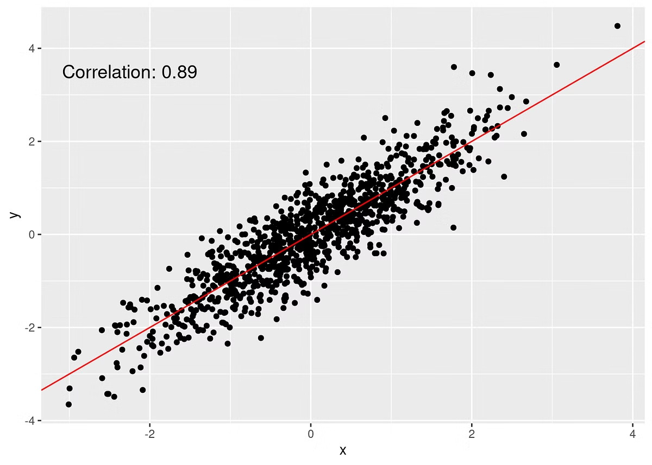
Conclusion and Future Roadmap
Foresight Finance is revolutionizing the investment landscape by empowering investors with accurate and timely insights using deep learning.
The platform's future roadmap includes expanding data sources, enhancing predictive models, and integrating advanced features to further optimize the investment process.
Foresight Finance's commitment to innovation is reflected in its future roadmap, which focuses on expanding data sources, refining predictive models, and integrating advanced features like automated portfolio optimization and personalized recommendations.

